Slide 1
Setting up of Raspberry Pi
Important software required:
Putty - https://the.earth.li/~sgtatham/putty/latest/w64/putty-64bit-0.72-installer.msi
VNC Viewer – https://www.realvnc.com/download/file/viewer.files/VNC-Viewer-6.19.715-Windows.exe
Linux platform - https://ubuntu.com/download/desktop/thank-you?version=18.04.3&architecture=amd64
Rufus - https://github.com/pbatard/rufus/releases/download/v3.6/rufus-3.6.exe
(3 and 4 download only if you want to make bootable drive )

Slide 2
Pre-requisites
It is here assumed that you have already “flashed” the Rasbian OS onto a memory card of 16 or 32GB space.
If you haven’t done it yet follow the previous ppt and get it done using ‘Etcher’ software.
Also ensure that after you have done it, boot the raspberry pi once with the memory card attached to it. It might take 4-5 min for the first boot.

Slide 3
Some common methods
If you already have access to any monitor where you can connect the raspberry pi via hdmi then the problem gets very simple.
The upcoming steps will help you to start the raspberry on your laptop without any display or wires, via wifi.

Slide 4
Step 1:
After the raspberry pi has successfully booted ( after waiting 4-5 min )once then switch the power off to it and take out the memory card.
Boot your laptop into linux ( either installed or running using bootable pen drive ) and attach the memory card to it using a card reader.

Slide 5
Step 2:
As soon as you insert your memory card, ensure that two drives are mounted in the file system on linux desktop. They are named ‘boot’ and ‘rootfs’.
If you can’t find the names then open the two directories and if one contains the folder named ‘etc’ then that’s the rootfs directory and other one is the boot directory.

Slide 6
Step 3:
Now open the boot directory and inside its window, right click anywhere and open a terminal.
In the terminal write the command: sudo nano ssh and press enter. You will notice a black document open up. Close it and type exit in the terminal.
You would see the ‘ssh’ blank document created in the boot directory. It is required to enable ssh in raspberry pi.

Slide 7
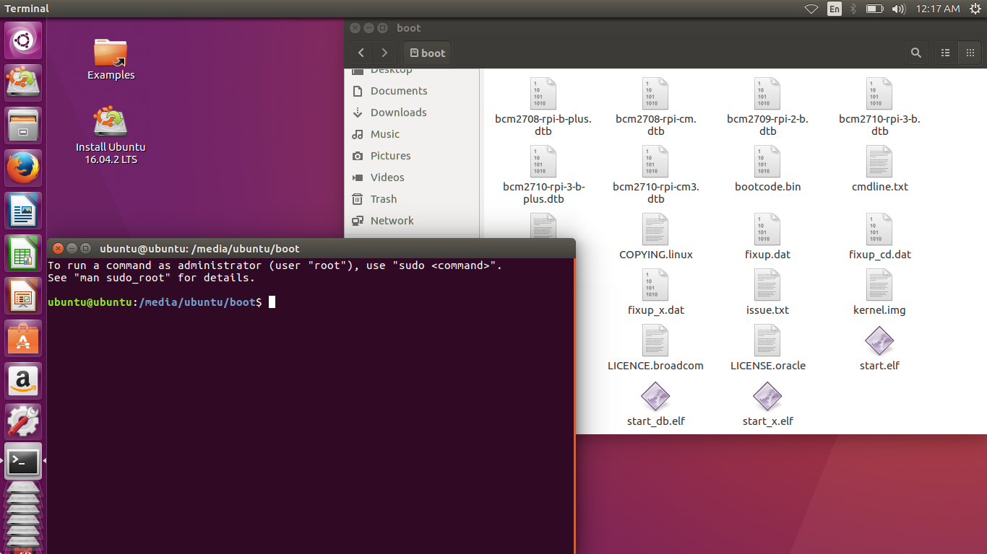

Slide 8
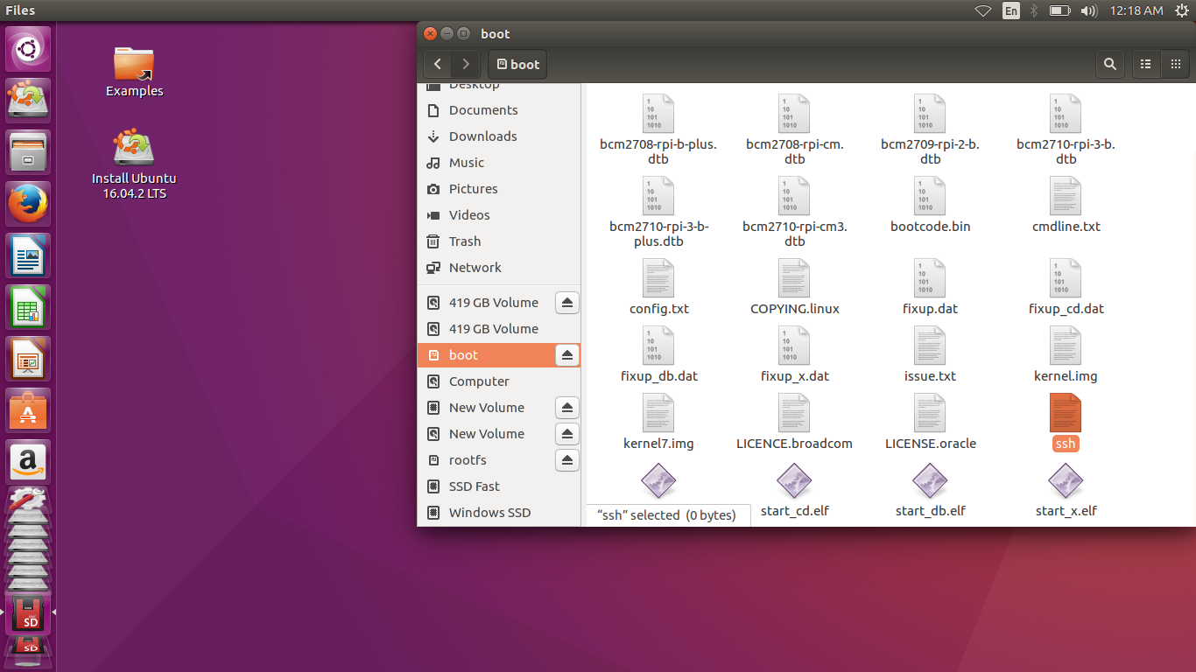

Slide 9
Step 4:
The work with the boot directory is done. Now close it and open up the rootfs directory.
Once you see the window of rootfs directory find the folder named ‘etc’ and go into it.
Now right click in any empty space and open terminal.
Into the terminal, write the following command : sudo nano dhcpcd.conf and press enter.

Slide 10
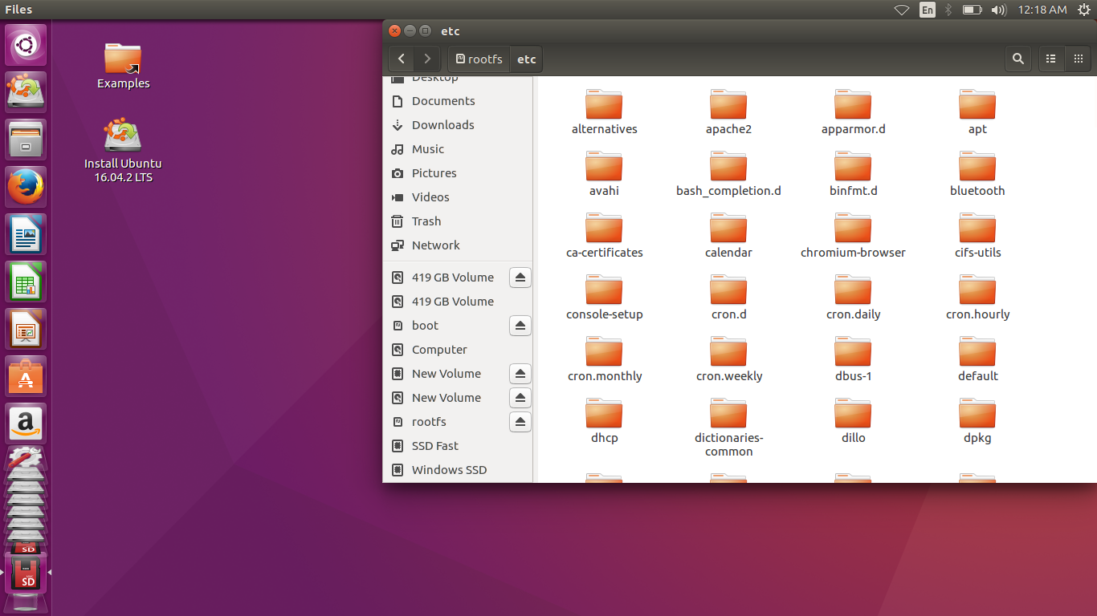

Slide 11
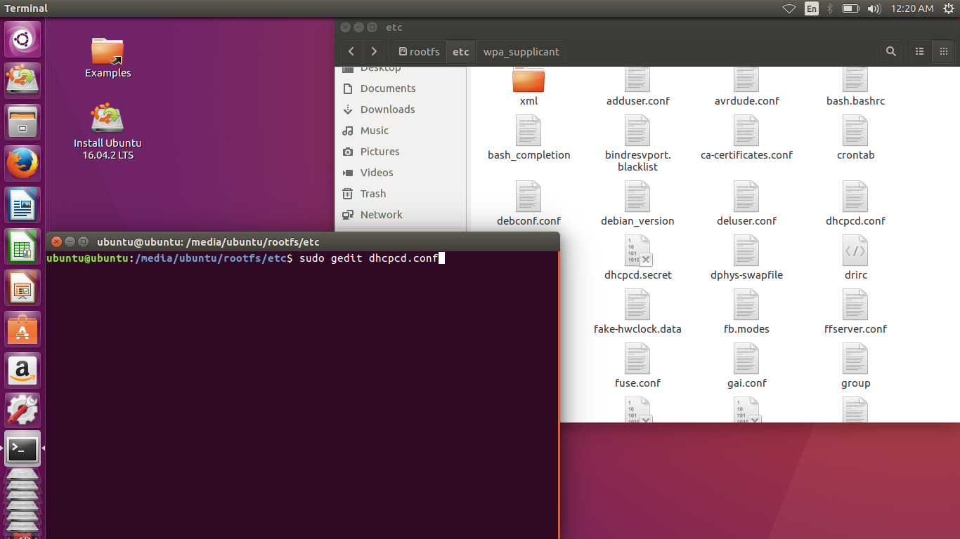

Slide 12
Step 5:
Once this command runs, you would see a file open with something written. The file is blank then recheck the command you wrote in the terminal.
Scroll to the bottom and add the following segment of code at the bottom exactly as it is shown here.( in the next slide)
Please make sure to change the last value of IP address ( here 123 ) to any value of your choice between 3 – 255.
Once done save the file ( upper right corner ) and exit. Also exit the terminal.

Slide 13
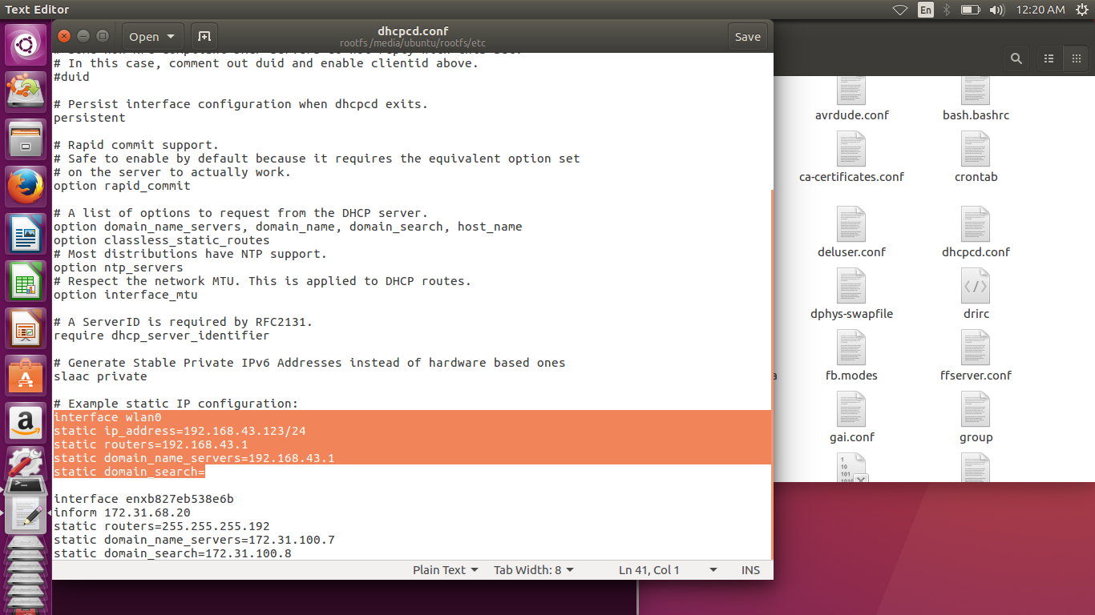

Slide 14
Step 6:
After completing the previous step, stay in the ‘etc’ folder and file the folder named ‘wpa_supplicant’ and go into it.
Once inside right click in some empty space and open terminal. In the terminal, write: sudo nano wpa_supplicant.conf and press enter.
A document would open with something written. If the document is blank recheck the command you wrote in the terminal. Follow the next step.

Slide 15
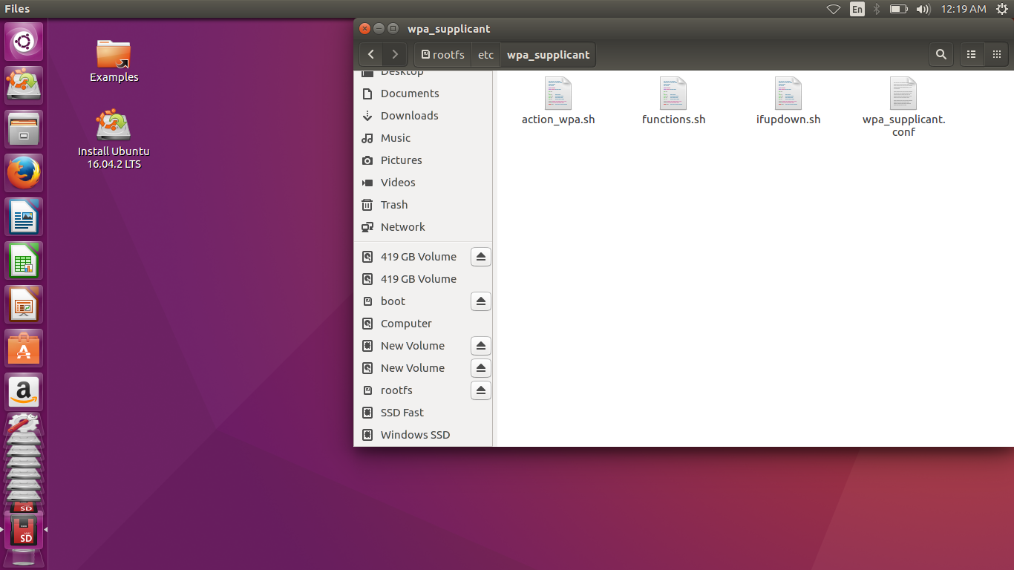

Slide 16


Slide 17
Step 6.1:
In that document enter the segment of code as shown in the image below, starting from “network” including the curly braces and content inside it.( image for referrance is shown in next page)
Keep your desired name in ssid section, and remember it. It is the name of the wifi network that the raspberry pi is required to connect and it should the same as the name of the hotspot you create.
You may or may not enter a password ( same as the password of the wifi hotspot ) in the psk section. If password is entered, key_mgmt = WPA-PSK else NONE.

Slide 18
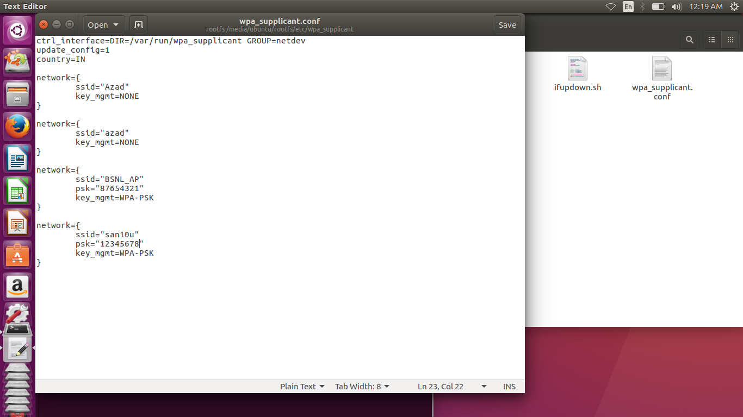

Slide 19
Step 6.2
Also change the country to IN instead of GB.
Now save the document ( upper right ) and exit. Also exit the terminal.
Close the folder and then close rootfs.
Properly unmount both the directories ( boot and rootfs ) by right clicking on it and take the memory card reader out.
Now the memory card is ready to tested.

Slide 20
Step 7:
Come to your smartphone and configure the wifi hotspot properties for your phone.
Under wifi name or ssid field for the hotspot, enter the same ssid you entered in the file while editing it in linux. Also if you kept password then enter the same password.
Boot your raspberry pi with memory card inserted and also turn on your wifi hotspot on your mobile phone.

Slide 21
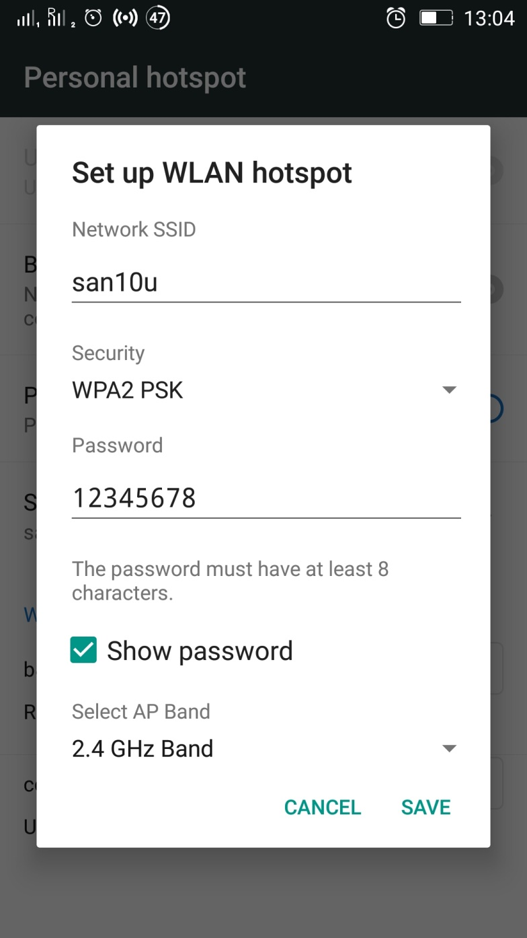

Slide 22
Step 8:
Wait for sometime until you see raspberry pi getting connected.
If your phone doesn’t show the name of the connection then just confirm that one device is connected with ip address as you have entered as static ip address. Download and use the app Hotspot Manager from play store in order to check the ip address of the connected devices.

Slide 23
Step 9
Download putty.exe on your windows pc and get your pc connected to the hotspot of your phone, which is also connected to the RasPi.
Open putty.exe and select ssh. Enter the ip address( same as the static ip address entered )
Keep the port as 22 and click on open.

Slide 24
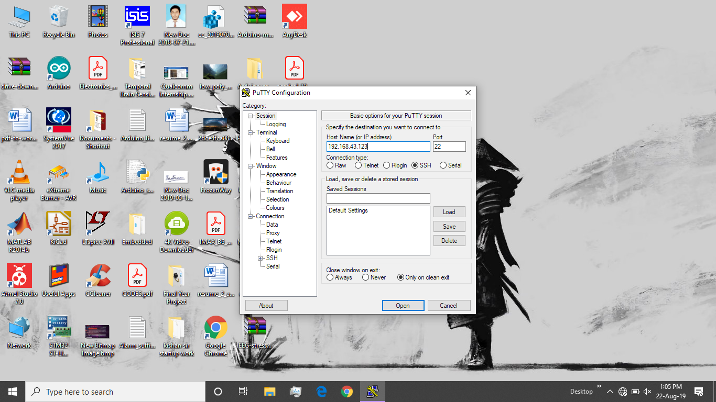

Slide 25
Step 10
If everything went right then you should see a window open and on top ‘login as’ should appear.( select yes for any previous dialog boxes)
Enter ‘pi’ in front of ‘login as’ and press enter.
Next you will be asked for the password. Enter it as ‘raspberry’. Note: You won’t be able to see the password you enter.
When you press enter, you will find yourself accessing the RasPi terminal.

Slide 26
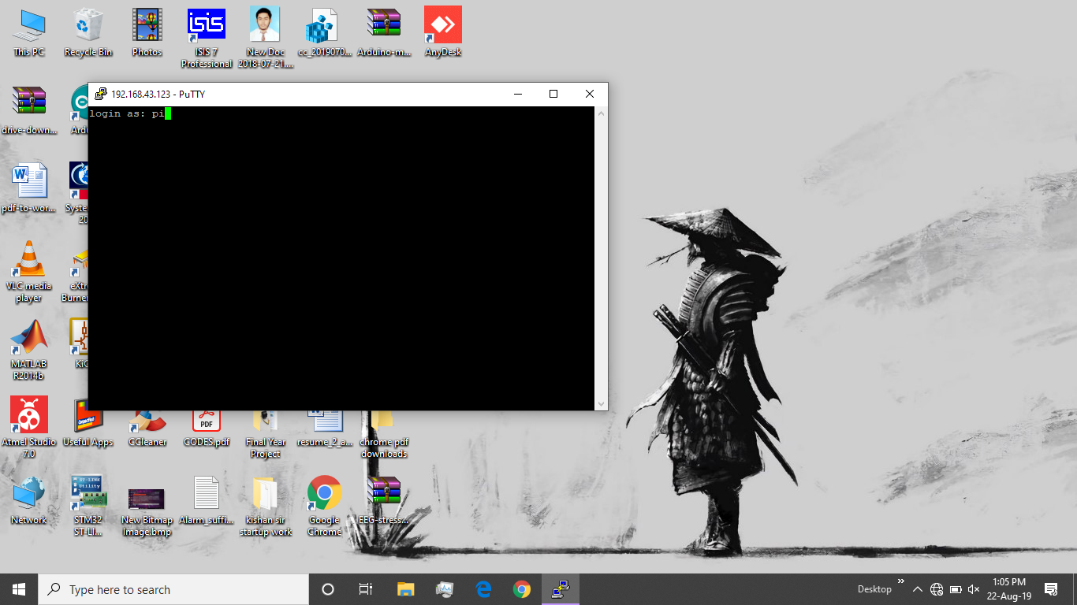

Slide 27


Slide 28
Step 11
In the terminal, write the command: sudo raspi-config
A window will open. Use the arrow buttons to navigate to ‘interfacing options’ and press enter.
Go on and choose ‘VNC’ and press enter. When asked to enable it press ok and then exit.

Slide 29
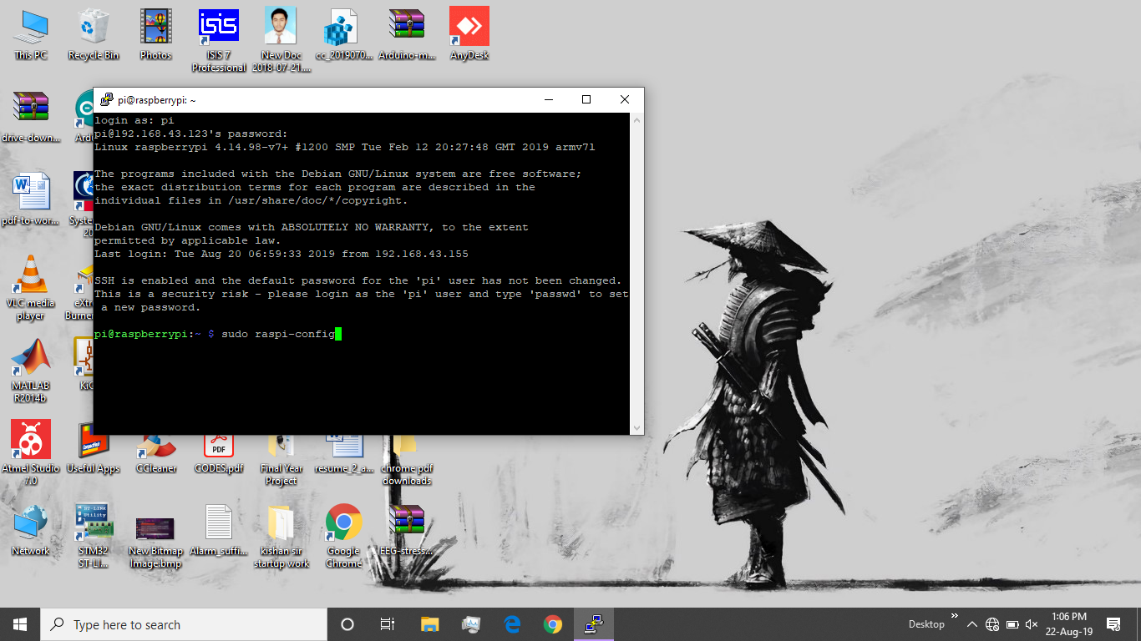

Slide 30
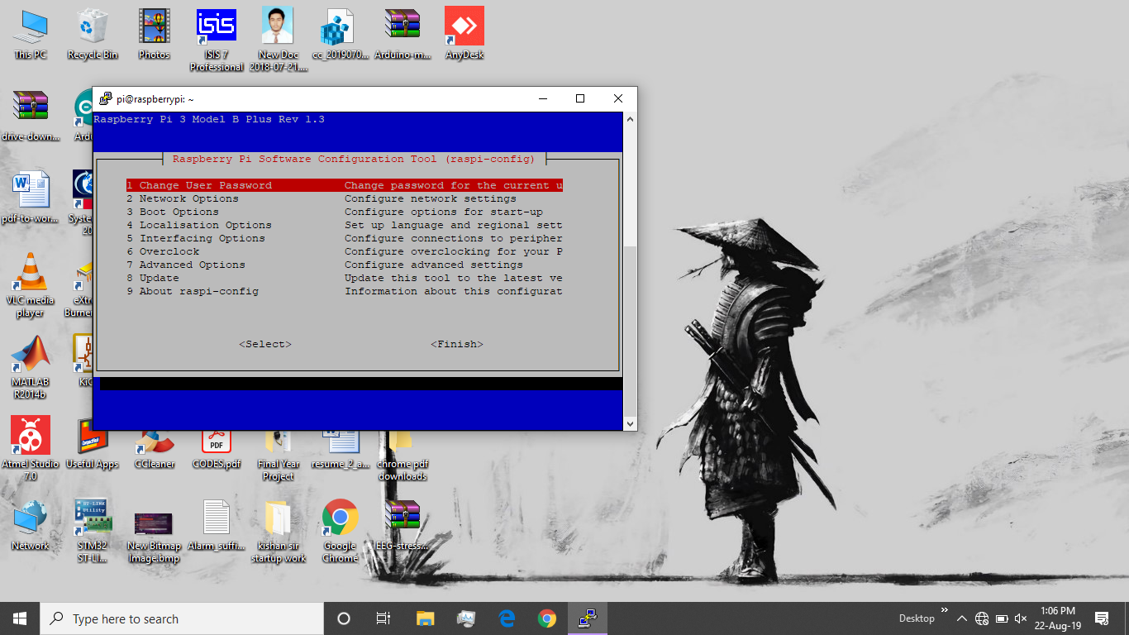

Slide 31
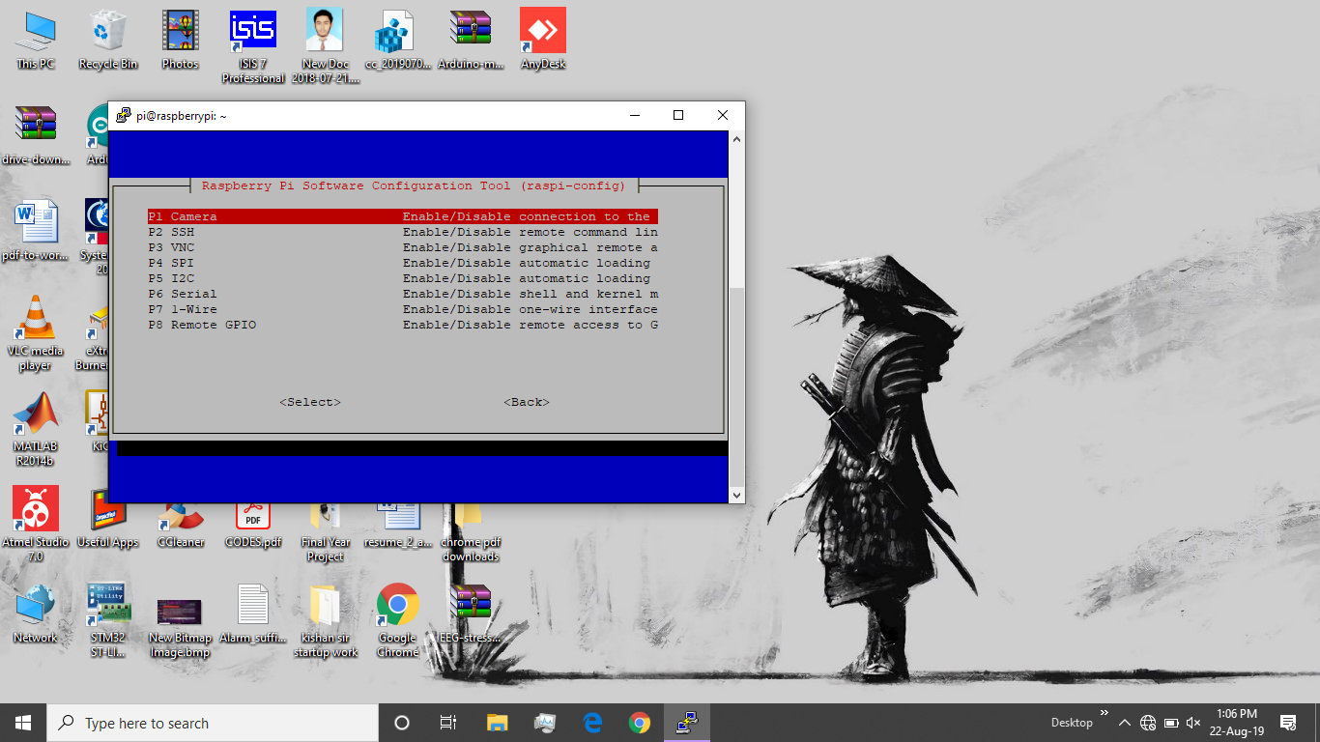

Slide 32
Step 12
All exit from the window by selecting finish.
Also exit from putty.
Download ‘VNC Viewer’ for windows and run it.
Go to file then new connection. Enter the same ip address in the field VNC Server and file a nickname.
Press ok and observe the connection with name you gave appear in the shown window.

Slide 33
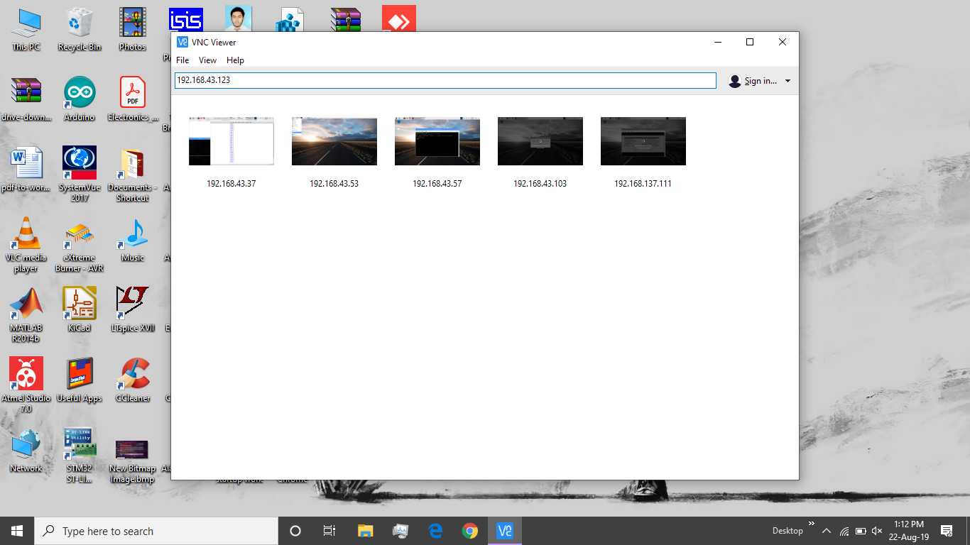

Slide 34
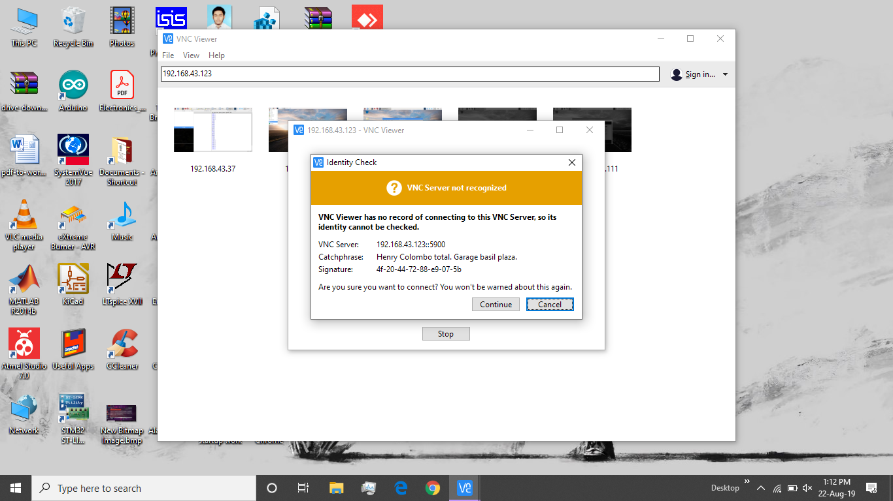

Slide 35
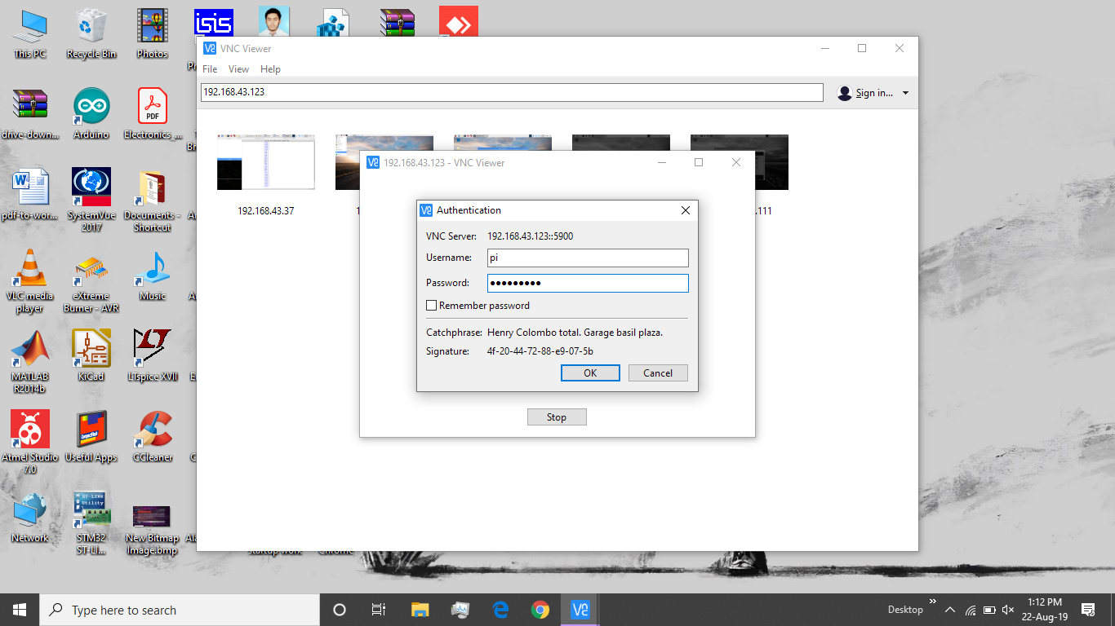

Slide 36
Step 13
Click on it and enter the username as pi and password as raspberry and press enter.
A desktop like window will open in front of you.
That window is the raspberry pi desktop screen.

Slide 37
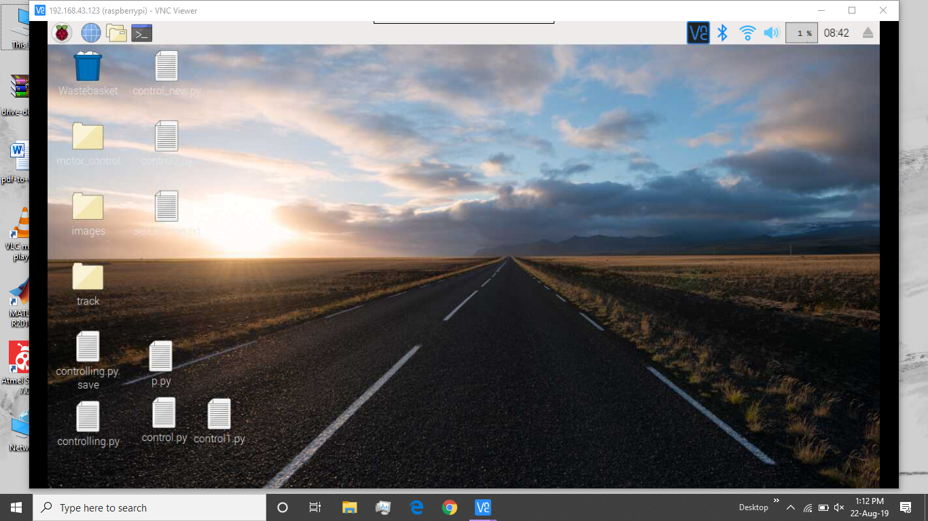

Slide 38
Completion
Congrats. If all the steps ran successfully then the RasPi is ready to use and that too, wirelessly.
If you are stuck at any step then ensure that every previous step you performed was done right.

